Slide 1
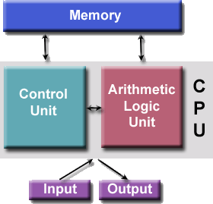
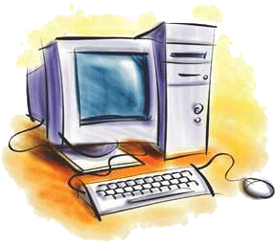
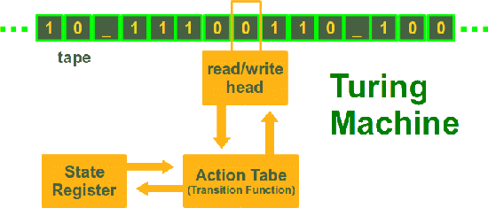
First course of Computer Science
Part V: Computer Architecture
-- A short history of computers
[3 persons + 4 Generations]
Notes:
2011年4月18日20:45:14
想了想,还是在讲完von Neumann后,在回过头来看看计算机的历史:已经知道了计算机到底是怎么做的,那么,再看它的历史,就会体会更多!

Slide 2
All for Computing faster
The first use of the word "computer" was recorded in 1613, referring to a person who carried out calculations, or computations, (http://en.wikipedia.org/wiki/Computer) such as navigational tables, tide charts, and planetary positions for astronomical almanacs.
Inventors have been searching for hundreds of years for a way to mechanize (that is, find a mechanism that can perform) this task.
Imagine you had a job where hour after hour, day after day, you were to do nothing but compute multiplications. Boredom would quickly set in, leading to carelessness, leading to mistakes. And even on your best days you wouldn't be producing answers very fast.
http://www.computersciencelab.com/ComputerHistory/History.htm

Slide 3
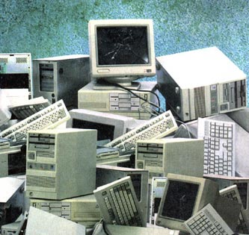
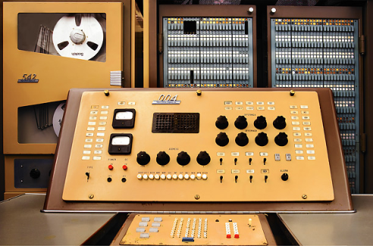
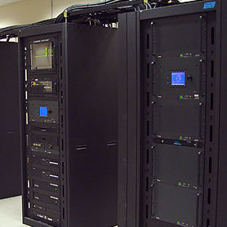
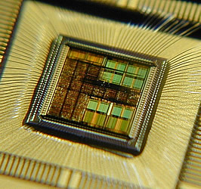
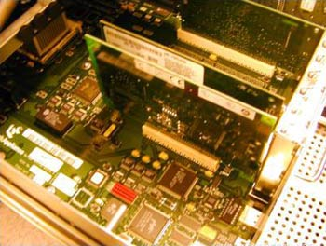
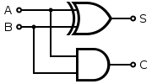
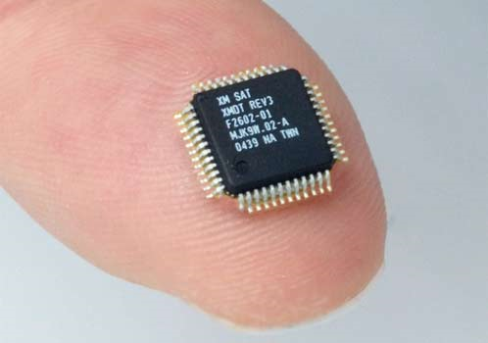
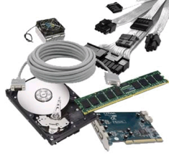
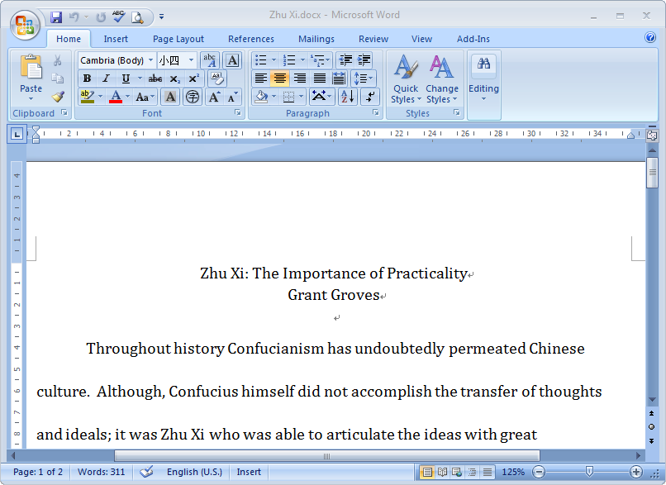
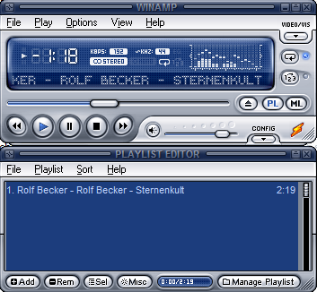
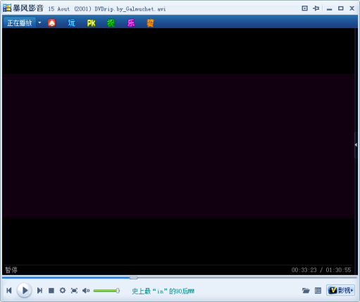
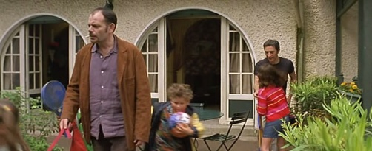
Big picture now!
{0, 1}
Computers
IC/VLSI
Components
+
Other peripherals
Logic
↓
Logic gate
(switch)
Digital
representations:
Number,
Character,
Instructions,
V.I.A etc.
Notes:
To understand more details about the modern computers [2012年7月16日17:24:05]

Slide 4
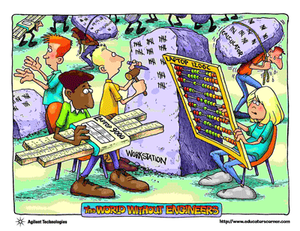
Computer History
Early Mathematics & Computation
Triggered by World War II
Three persons
The Modern Era
Four generations

Slide 5
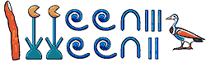
Early Mathematics & Computation
Babylonians and Egyptians, > 3000 yrs ago
numerical methods for generating tables of square roots, multiplication, trig
Applications: navigation, agriculture, taxation
Greeks, > 3000 yrs ago
geometry and logic
Indians, ~ 600 AD
started using placeholders and a decimal number system, similar to modern
idea spread to Middle East
Arabs and Persians ~ 800 AD
algorithms
PPTs from others\Invitation to Computer Science\parasol.tamu.edu_~welch_teaching_181.s10\history.pptx

Slide 6
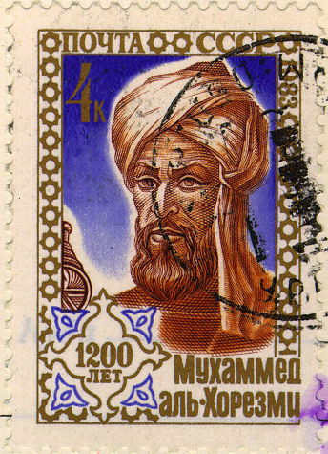
A Famous Arab Mathematician
Abu Jafar Mohammed Ibn Musa Al-Khowarizmi
In early 800s AD
Worked at center of learning in Baghdad
Wrote book: Hisab Al Jabr Wal-Mugabalah
Described how to compute several practical problems, including linear and quadratic equations
Translated into Latin, spread throughout Europe
Solidified number system in use now: “Arabic numerals”
Al-Khowarizmi gives us the word “algorithm”
fig. from Donald Knuth's website
PPTs from others\Invitation to Computer Science\parasol.tamu.edu_~welch_teaching_181.s10\history.pptx
Notes:
Baghdad [ˈbæɡdæd] n.巴格达(伊拉克首都)

Slide 7
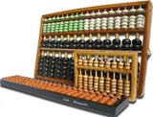
Early Computing Devices
Abacus
About 3000 BC
Different types, developed over time
Common wire/bead: about 500 BC
Some still in use today
John Napier’s Bones
1617: Sticks with numbers on them
Use to do 4 basic arithmetic operations
William Oughtred’s Slide Rule
1622: Sticks with logarithmic scale, slide along
Much more complex calculations
Used well into 20th century (replaced by handheld calculator)
fig from http://www.ee.ryerson.ca/~elf/abacus
PPTs.2011\PPTs from others\Invitation to Computer Science\parasol.tamu.edu_~welch_teaching_181.s10\history.ppt

Slide 8
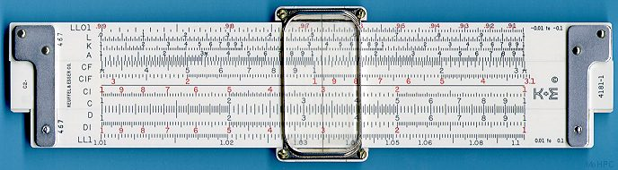
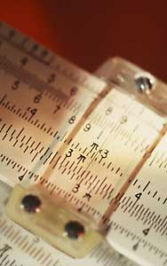
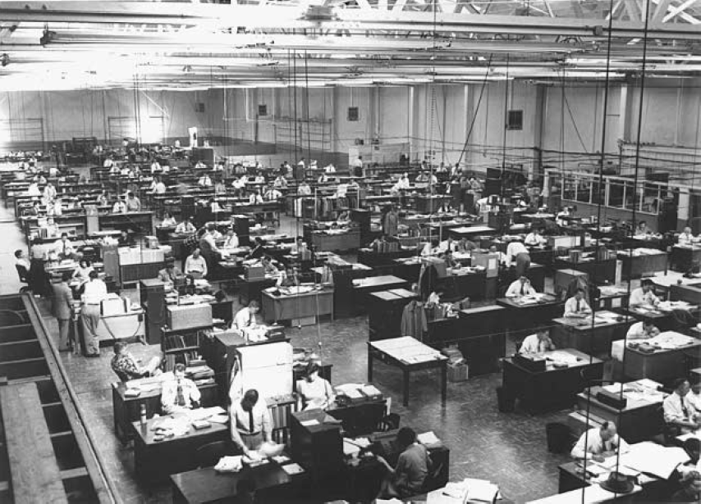
Slide rule
"A History of Modern Computing" (2nd), Paul E. Ceruzzi, ISBN 0-262-53203-4. MIT Press, 2003.
Human "computers" at work at North American Aviation, Los Angeles, in the early 1950s.
The man at the lower left is looking up a number on a slide rule. The rear half of the room is set up for drafting. (Source: NASM.)

Slide 9
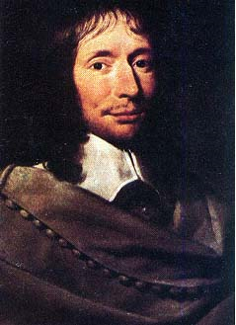
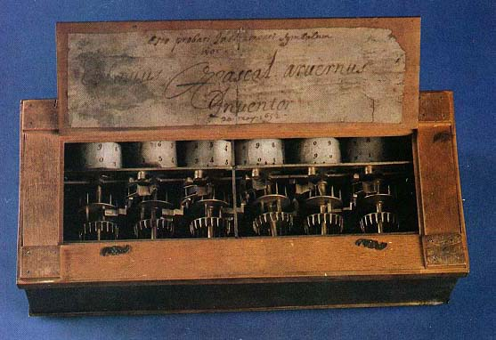
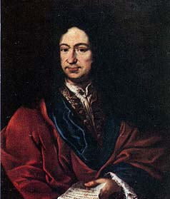
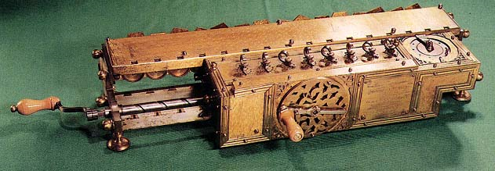
More Early Computing Devices
Blaise Pascal
1642: First numerical calculating machine (addition and subtraction)
Gottfried Leibniz
1673: 4-function mechanical calculator (addition, subtractions, multiplication, division)
fig from http://www.tcf.ua.edu/AZ/ITHistoryOutline.htm
Used cogs and gears
Showed mechanization can simplify and speed up numerical calculations

Slide 10

Are These Devices Computers?
Not considered general-purpose computers
They lack
memory
ability to be programmed

Slide 11
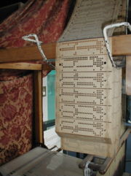
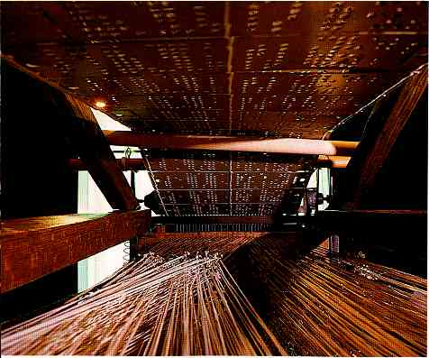
First Programmable Device with Memory
fig from Wikipedia, Jacquard loom entry
A loom [织布机]!
Used to weave cloth with patterns
Invented by Joseph Jacquard, France, 1804
Automated loom using punched cards to create pattern
hole in card at a certain place causes change in the weave at corresponding place in the fabric

Slide 12
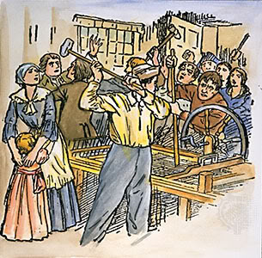
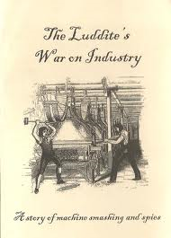
Jacquard Loom
Memory: the cards
Programmable: change the cards
Capture human expertise in a machine
Target of Luddite movement [勒德运动]
riots against Industrial Revolution
threatened craft guilds
fig from britannica.com
英国工人以破坏机器为手段反对工厂主压迫和剥削的自发工人运动。首领称为卢德王，故名。
Notes:
Luddite [ˈlʌdait]n.勒德分子（1811-1816年英国手工业);强烈反对提高机械化和自动化的人

Slide 13
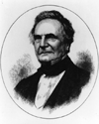
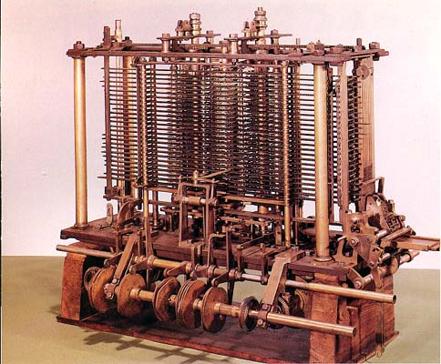
Charles Babbage & Analytical Engine
1833: Designed the “Analytical Engine”
Could not get funding, since never finished first machine, but fully designed
to be steam-powered
This was the first general computational device!
Separate storage from calculation
Familiar parts:
mill <=> ALU
store <=> memory
operator <=> control unit
Output [Punch cards. (打孔机)]
<=> input/output
Used punched cards
fig from www.sciencemuseum.org.uk

Slide 14
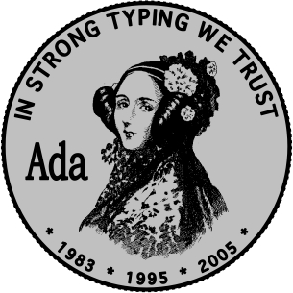
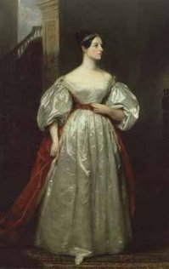
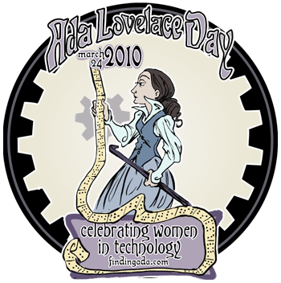
Ada Lovelace
http://brideswell.com/content/audio-production/ada-lovelace-day-delia-derbyshire/
Augusta Ada Byron, Countess of Lovelace
Daughter of poet Lord Byron
Friend of Charles Babbage
Translated, edited, and commented on document describing Babbage’s Analytical Engine
fig from women.cs.cmu.edu/ada
Described its potential as a general purpose computer
Wrote “programs” that could be run on it. As a result, she is often considered the world’s first computer programmer.
Wrote about potential uses, even for computer music

Slide 15


U.S. Census & Computer
Taken every 10 years
By late 1800s, was becoming more difficult
1880 census not tabulated until 1888
Serious doubt that 1890 census could be finished before time for following census
Competition held to develop automatic enumeration and tabulation of census data
A fundamental need for “large-scale” computing

Slide 16
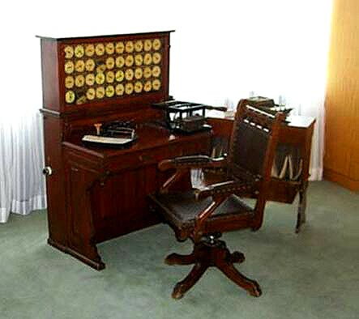
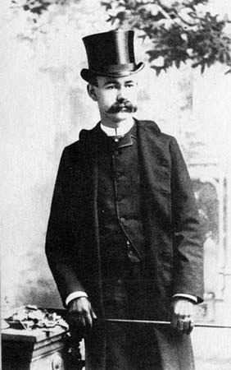
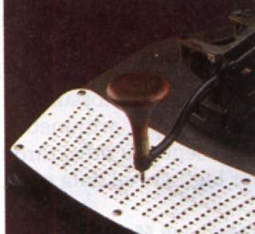
Herman Hollerith
Herman Hollerith developed tabulating machine
Developed machines for encoding information on punched cards
Cards could be sorted and tabulated
1890 census completed in 2 years with Hollerith’s machines
Also saved millions of dollars
fig from www.columbia.edu/acis/
history/census-tabulator.html

Slide 17

Further Development
fig from www-03.ibm.com/ibm/history/
Need faster automatically computing machine ➔ Electro-s(electric and electronic)
Work continued on machines to add, tabulate, record.
Charles Flint: Computing, Tabulating, Recording (CTR) company, followed up on Hollerith’s work.
Thomas J. Watson renames CTR to International Business Machines (IBM) in 1924.
Individual machines were created for each stage of a process
For example, separate machines to count, sort.
Most machines encoded information on punched cards.

Slide 18
Computer History
Early Mathematics & Computation
Triggered by World War II
Three persons
The Modern Era
Four generations

Slide 19
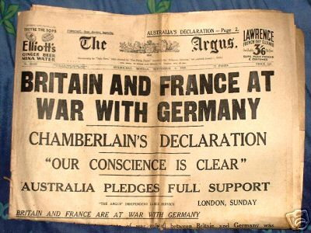
Impact of World War II
Applications of the 1940's:
ballistics tables
troop deployment data
secret codes
fig from www.diggerhistory.info
Several research projects, funded by military, focused on developing computers
on both sides

Slide 20
War-Time Projects
Colossus: England, Alan Turing
cracked German Enigma code
shrouded in secrecy until 1970's
ABC: Iowa State, John Atanasoff & Clifford Berry
solve systems of linear equations
MARK I & Howard Aiken
used binary values (0/1) instead of decimal (0 to 9), learned from Atanasoff
ENIAC
Electronic Numerical Integrator and Computer

Slide 21
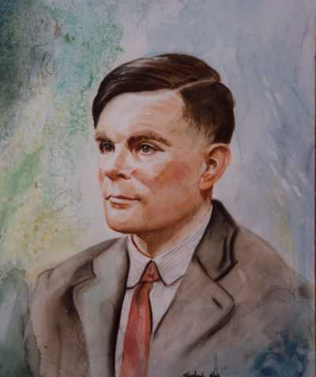
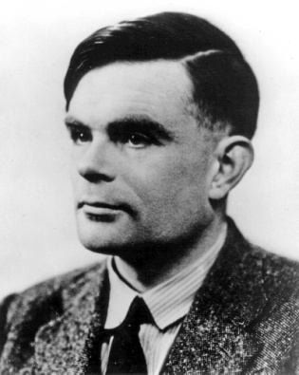
Alan Mathison Turing
Alan Mathison Turing was one of the great pioneers of the computer field. He inspired the now common terms of "The Turing Machine" and "Turing's Test.“
The test (written at 1950) consisted of a person asking questions via keyboard to both a person and an intelligent machine. He believed that if the person could not tell the machine apart from the person after a reasonable amount of time, the machine was somewhat intelligent. This test has become the “holy grail“ [圣杯] of the artificial intelligence community.
His intelligence and foresight made him one of the first to step into the information age.
(1912-1954):
the Brilliant Mind
http://ei.cs.vt.edu/~history/Turing.html
http://www.shela-nye.com/watercolors.shtml

Slide 22
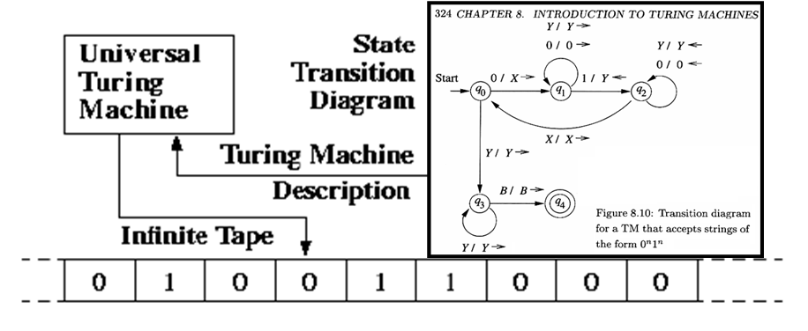
Turing machine
Control unit
Input
Output
The theoretical model of the computers, whose power covers even what the supercomputer today has.
Notes:
which means all the problems that could be coped with the supercomputers today must be solved by Turing machine too.

Slide 23
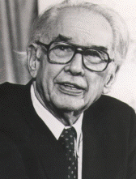
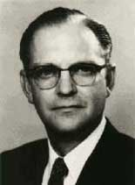
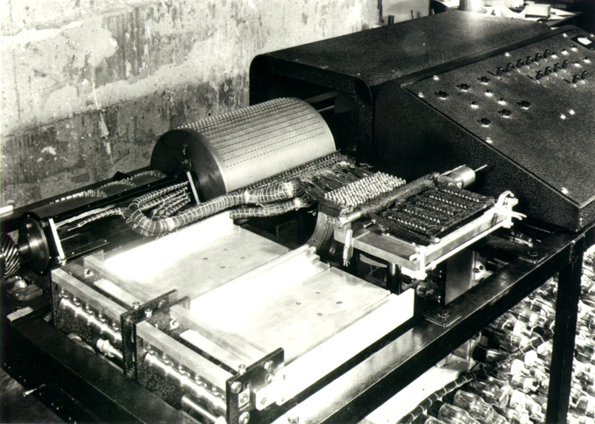
John Vincent Atanasoff [阿塔纳索夫]
The other precursor to combine the electronics and binary together
1937, one of the earliest researchers who thought to use resistant [电阻], amplifier [放大器] and capacitor [电容器] etc. to build the electronic computer.
He found that it’s quite convenient to implement the calculation components based on binary system
Switches, just on and off
Atanasoff-Berry Computer (ABC)
1942
John Atanasoff
(1903 – 1995)
Clifford Berry
Notes:
While the ABC was never fully-functional, it won a patent dispute relating to the invention of the computer when Atanasoff proved that ENIAC co-designer John Mauchly had come to see the ABC shortly after it was completed.
Built at Iowa State College (now University), the Atanasoff-Berry Computer (ABC) was designed and built by Professor John Vincent Atanasoff and graduate student Cliff Berry between 1939 and 1942.

Slide 24
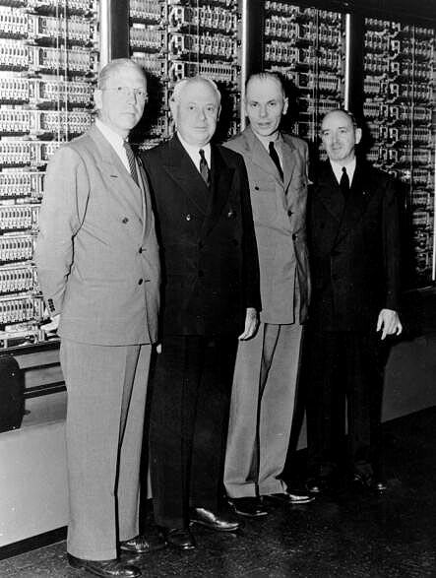
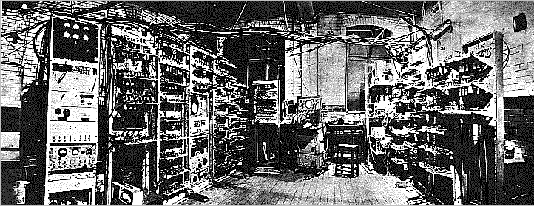
Howard Aiken & MARK I
Funded by Navy and IBM, at Harvard
1943
general-purpose programmable computer
used relays, magnets and gears
used binary values (0/1) instead of decimal (0 to 9)
used vacuum tubes and electric current (on/off) instead of 10-toothed gears
memory: 72 numbers
speed: 23-digit multiplication in 4 seconds
fig from www-03.ibm.com/ibm/history/

Slide 25
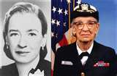
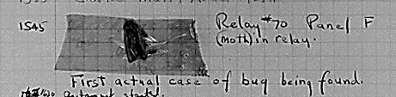
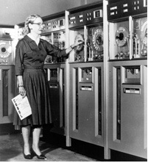
Grace Murray Hopper
Joined Naval Reserve in 1943
As Lieutenant, became one of the first programmers of the Mark I
Noted difficulty of programming in machine language
Wanted way of specifying programming more naturally
Created the first compiler, A-O
Subsequently created other compilers, became strong proponent of compilers/programming languages
Developed programming languages, notably COBOL (1959)
fig from cs.vassar.edu/history/hopper
fig from computerhistory.org
Notes:
proponent[prəˈpəunənt]n.(某事业、理论等的)支持者, 拥护者

Slide 26


ENIAC
"Electronic Numerical Integrator and Computer"
1946
Motivating application: calculate firing tables (how to aim gun depending on distance, wind speed, temp, etc.)
Funded by Army at Univ. of Penn.
John Mauchly & Presper Eckert lead designers
First fully electronic general-purpose computer
Vacuum-tube based
Required rewiring to change program originally
100 feet long, 10 feet high, 30 tons
1000 times faster than Mark I
figs from www.library.upenn.edu/exhibits/rbm/mauchly/jwm8b

Slide 27

Aspect Still Missing…
All these projects still missing a key feature of modern computers
Programming these machines was done externally with
Wires
Connectors
Plug-boards
Memory stored only data, not instructions
To change the program, need to rewire
Ex: 6000 switches on ENIAC

Slide 28
http://c2.com/cgi/wiki?EarlyProgramming
Notes:
Excerpt: Starting in 1906, tabulators were made more flexible by addition of a wiring panel to let users control their actions to some degree, thus allowing the same machine to be sold into different markets (government, railroad, etc) and used for different purposes. But this also meant that if one machine were to be used for different jobs, it would have to be rewired between each job, often a lengthy process that kept the machine offline for extended periods. In 1928, IBM began to manufacture machines with removeable wiring panels, or "plugboards", so programs could be prewired and swapped in and out instantly to change jobs. The plugboard fits into a receptacle in the machine...
Thus, "programmers" existed as a "standard" career at least back to 1928, and perhaps earlier if you don't include removable panels.

Slide 29

Notes:
http://www.cs.auckland.ac.nz/historydisplays/FifthFloor/LogicAndSwitching/HarvardMark1/HarvardMark1Pictures.php

Slide 30


Von Neumann Architecture
John Von Neumann, mathematician, physicist, chemist, computer scientist,… at Princeton
worked on ENIAC
realized shortcoming
Key idea:
encode instructions as binary values and store in memory along with data
To change program, rewrite sequence of instructions
fig from mathdl.maa.org
fig from cs.cmu.edu/ref/pgss/lecture/11

Slide 31

Three persons
Alan Mathison Turing
John Vincent Atanasoff
John Von Neumann
Theoretical model of modern computer
Combine the electronics and binary together
Common architecture of modern computers

Slide 32
Computer History
Early Mathematics & Computation
Triggered by World War II
Three persons
The Modern Era
Four generations

Slide 33

The Modern Era, 1950 - Present
Changes more evolutionary than revolutionary
Focused on making computers
faster
smaller
cheaper
more reliable
easier to use
Conventionally divided into rough "generations"

Slide 34


First Generation (1940-1956) Vacuum Tubes
The first computers used vacuum tubes for circuitry and magnetic drums for memory, and were often enormous, taking up entire rooms.
They were very expensive to operate and in addition to using a great deal of electricity, generated a lot of heat, which was often the cause of malfunctions.
Vacuum Tubes [真空管]
PPTs.2010\PPTs from others\www.cs.hiram.edu_~oliphantlt_cpsc171_slides\lecture0.ppt

Slide 35



Internals with lots of vacuum tubes
http://davewhitmore.net/Images/computer_history.htm

Slide 36

http://mprc.pku.edu.cn/courses/organization/autumn2011/slide11/CHX11_org02_history.pdf

Slide 37

http://mprc.pku.edu.cn/courses/organization/autumn2011/slide11/CHX11_org02_history.pdf

Slide 38


The IBM 650 Magnetic Drum Data Processing Machine was announced 2 July 1953 (as the "Magnetic Drum Calculator", or MDC), but not delivered until December 1954.
IBM pioneered the arrangement of vacuum tubes in pluggable modules such as IBM 650.
Left to right:
Type 650 Power Supply
Type 650 Console Unit
Type 533 Read-Punch Unit
http://www.columbia.edu/acis/history/650.html

Slide 39

http://mprc.pku.edu.cn/courses/organization/autumn2011/slide11/CHX11_org02_history.pdf

Slide 40

http://mprc.pku.edu.cn/courses/organization/autumn2011/slide11/CHX11_org02_history.pdf

Slide 41

http://mprc.pku.edu.cn/courses/organization/autumn2011/slide11/CHX11_org02_history.pdf

Slide 42
First Generation (1940-1956) Vacuum Tubes
First generation computers relied on machine language, the lowest-level programming language understood by computers, to perform operations, and they could only solve one problem at a time.
Input was based on punched cards and paper tape, and output was displayed on printouts.

Slide 43


Second Generation (1956-1963) Transistors [晶体管]
Transistors replaced vacuum tubes and ushered in the second generation of computers.
The transistor was invented in 1947 but did not see widespread use in computers until the late 1950s.
The transistor was far superior to the vacuum tube, allowing computers to become smaller, faster, cheaper, more energy-efficient and more reliable than their first-generation predecessors.
Though the transistor still generated a great deal of heat that subjected the computer to damage, it was a vast improvement over the vacuum tube.
some historians claim the transistor was the most important invention of the 20th century

Slide 44


Early Logic Modules: Circuit board with transistors
http://davewhitmore.net/Images/computer_history.htm

Slide 45

? Computer - Mainframe
Mainframe System
http://www.answers.com/topic/mainframe
In the "ancient" mid-1960s, all computers were mainframes, since the term referred to the main CPU cabinet. Today, it refers to a class of ultra-reliable medium and large-scale servers designed for enterprise-class and carrier-class operations.
Mainframes support symmetric multiprocessing (SMP) with several dozen central processors in one system. They are highly scalable. Built with multiple ports into high-speed caches and main memory, a mainframe can address thousands of gigabytes of RAM. They connect to high-speed disk subsystems that can hold terabytes of data.

Slide 46


Slide 47

IBM 7094
But it can also be made perfect!

Slide 48

IBM 7094

Slide 49


IBM 1401 – The legendary Data processing system
http://www.magcloud.com/browse/Issue/37765
http://www.irishtimes.com/newspaper/finance/2009/1113/1224258713702.html

Slide 50

IBM 140x: 1401, 1402, 1403, and 1406
http://ibm-1401.info/1401-CHM-Left-Labeled-.jpg

Slide 51
Second Generation (1956-1963) Transistors [晶体管]
Second-generation computers still relied on punched cards for input and printouts for output.
Second-generation computers moved from cryptic binary machine language to symbolic, or assembly languages, which allowed programmers to specify instructions in words.
High-level programming languages were also being developed at this time, such as early versions of COBOL and FORTRAN.
These were also the first computers that stored their instructions in their memory, which moved from a magnetic drum to magnetic core technology.

Slide 52



Third Generation (1964-1971) Integrated Circuits [集成电路]
The development of the integrated circuit was the hallmark of the third generation of computers.
Transistors were miniaturized and placed on silicon chips, called semiconductors, which drastically increased the speed and efficiency of computers.
1958
Kilby integrated circuit

Slide 53

IBM 360
The whole system – mainframe (IBM360), input/output machine, and tape machine etc.
System unit/Mainframe
http://www.techcn.com.cn/index.php?doc-view-140320.html

Slide 54


Slide 55
Third Generation (1964-1971) Integrated Circuits [集成电路]
Instead of punched cards and printouts, users interacted with third generation computers through keyboards and monitors and interfaced with an operating system, which allowed the device to run many different applications at one time with a central program that monitored the memory.
Computers for the first time became accessible to a mass audience because they were smaller and cheaper than their predecessors.

Slide 56

Fourth Generation (1971-Present) Microprocessors
The microprocessor brought the fourth generation of computers (at first, VLSI -- very large-scale integration: 大规模集成电路), as thousands of integrated circuits were built onto a single silicon chip.
What in the first generation filled an entire room could now fit in the palm of the hand.

Slide 57
Trends & Classes
Micro
Networked
A.I
Macro
Super
Chasing the high processing speed
PC
Multimedia
Embedded System
Wearable devices
everywhere
Workstation
PDA
· As these small computers became more powerful, they could be linked together to form networks, which eventually led to the development of the Internet.
·Fourth generation computers also saw the development of GUIs, the mouse and handheld devices.
TJU.计算机导论.WXJ\讲稿1.ppt

Slide 58






These are also computers
supercomputer
A videogame console
microcontroller
PDAs, Portable Players, and Smart Phones

Slide 59

http://mprc.pku.edu.cn/courses/organization/autumn2011/slide11/CHX11_org02_history.pdf

Slide 60

http://mprc.pku.edu.cn/courses/organization/autumn2011/slide11/CHX11_org02_history.pdf
Everyone now is rich man then!

Slide 61
http://mprc.pku.edu.cn/courses/organization/autumn2011/slide11/CHX11_org02_history.pdf
PPR of computers of 1951 - 1996
Size
(in³)
Power
(watt)
Performance
(add/sec)
MM
(kb)
Price
($)
PPR with UNIVAC
Modified Price
(1996$)
PPR with UNIVAC
Year
Name

Slide 62
Present and Beyond: Artificial Intelligence?
Fifth generation computing devices (?), based on artificial intelligence [人工智能], are still in development, though there are some applications, such as voice recognition, that are being used today
Its goal is to develop devices that respond to natural language [自然语言] input and are capable of learning and self-organization [自组织].
The use of parallel processing [并行处理] and superconductors [超导] is helping to make artificial intelligence a reality.
Quantum computation [量子计算] and molecular [分子] and nanotechnology [纳米技术] will radically change the face of computers in years to come.
http://www.webopedia.com/DidYouKnow/Hardware_Software/2002/FiveGenerations.asp
Notes:
点一下跟之前的分类是不协调的

Slide 63

往右一点，然后，你会想让我调用这个程序，
之后为另一个程序搜索这些文件，再然后，扫描那个磁盘，最后，老板你看，我就已经将它放到我的数据库里了。
但是，真不敢相信：你自己竟然已经忘了！
"Great Ideas in Computer Science with Java", Alan W. Biermann and Dietolf Ramm, Massachusetts Institute of Technology, 2002

